Slide 1
Agenda for today: Laser cavity design
Today we will use Lumerical FDTD to study a nanowire laser cavity
Review conditions for lasing in general laser cavity
Design and analysis of ZnO nanowire laser cavity

Slide 2
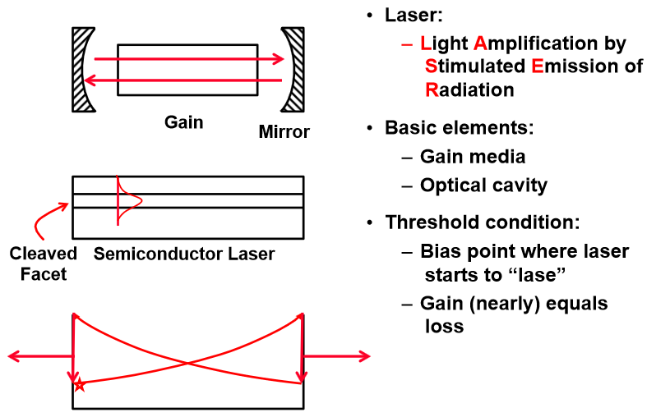
Review: basic laser concepts

Slide 3
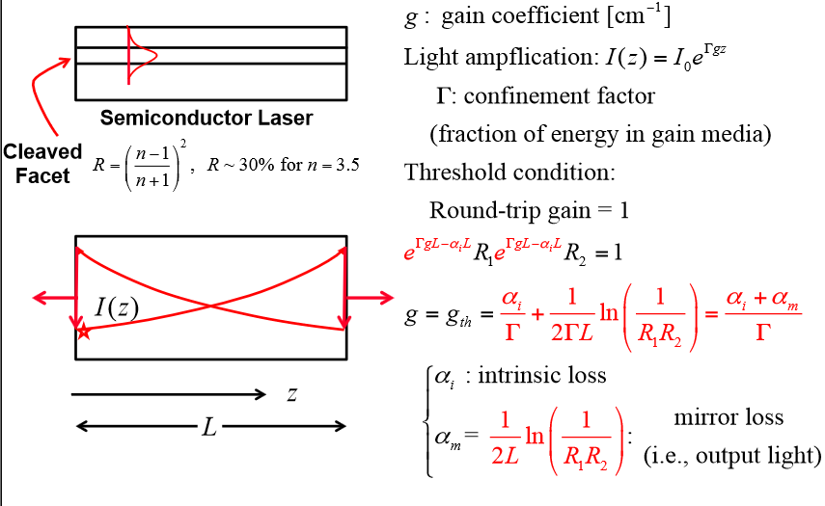
Review: basic laser concepts

Slide 4
ZnO nanowire laser cavity
As an interesting case study, let’s examine a somewhat exotic laser cavity consisting of a ZnO nanowire laser cavity
“Bottom-up” fabricated ZnO nanowires grown on sapphire substrate
Cavity is formed by mirror between top facet and air and bottom facet and sapphire substrate
How much gain do we need to observe lasing in such a cavity?
Huang, Michael H., et al. "Room-temperature ultraviolet nanowire nanolasers." science 292.5523 (2001): 1897-1899.

Slide 5
Back-of-the envelope calculation of threshold gain for ZnO nanowire
Mirror #1
Assume plane wave normal incidence:
$$R={\left(\frac{n_{ZnO}−n_{air}}{n_{ZnO}+n_{air}}\right)}^{2}=18\%$$
ZnO nanowire (n = 2.45)
Mirror #2
Assume plane wave normal incidence:
$$R={\left(\frac{n_{ZnO}−n_{sapph}}{n_{ZnO}+n_{sapph}}\right)}^{2}=2\%$$
Sapphire (n = 1.8)

Slide 6
Back-of-the envelope calculation of threshold gain for ZnO nanowire
Mirror #1
$$g_{th}=\frac{α_{i}}{Γ}+\frac{1}{2ΓL}\ln\left(\frac{1}{R_{1}R_{2}}\right)$$
Assume nanowire length is 10 µm,
confinement factor is unity, and negligible
internal loss
ZnO nanowire (n = 2.45)
$$g_{th}\sim \frac{1}{(2)(1)(10×{10}^{−4})}\ln\left(\frac{1}{(0.18)(0.02)}\right)$$
Mirror #2
$=2800 {cm}^{−1}$
Sapphire (n = 1.8)
(this is pretty high!)

Slide 7
Lumerical simulation
Let’s use Lumerical FDTD to get a more accurate value for the mirror reflectivity and confinement factor to determine the threshold gain
We could simulate the entire structure and determine the Q-factor to get the threshold gain however it’s faster to simply simulate the mirror reflectivity for each mirror and use the expression on the previous page

Slide 8
FDTD procedure
(3) Monitor reflected power with a field monitor
(1) Launch waveguide mode
(2) Guided mode will reflect off the mirror. Some light will radiate away but some will reflect in the backward direction
reflected light
radiated light

Slide 9
Guided mode source
Open the file ZnO_nanowire_laser_mirror.fsp
This file contains the geometry necessary to simulate reflectivity from both mirrors of the ZnO nanowire cavity
ZnO has hexagonal cross-section with 130nm diameter
We will assume lasing occurs at the ZnO bangap wavelength of 370nm and therefore center our simulation range at that wavelength

Slide 10
Computational domain
PML
air
nanowire
Mode source
Power monitor
Movie monitor

Slide 11
Mode source

Slide 12
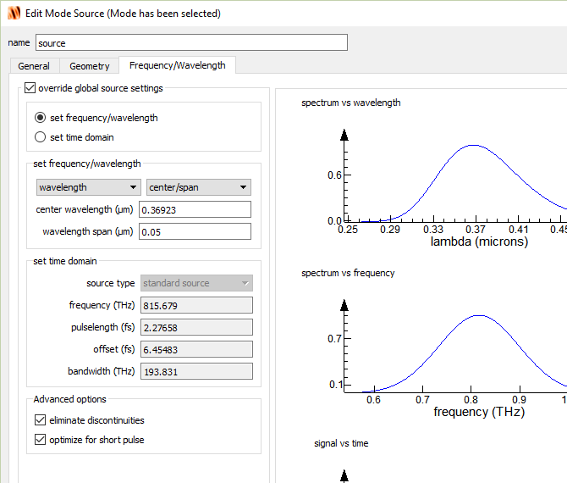
Mode source

Slide 13
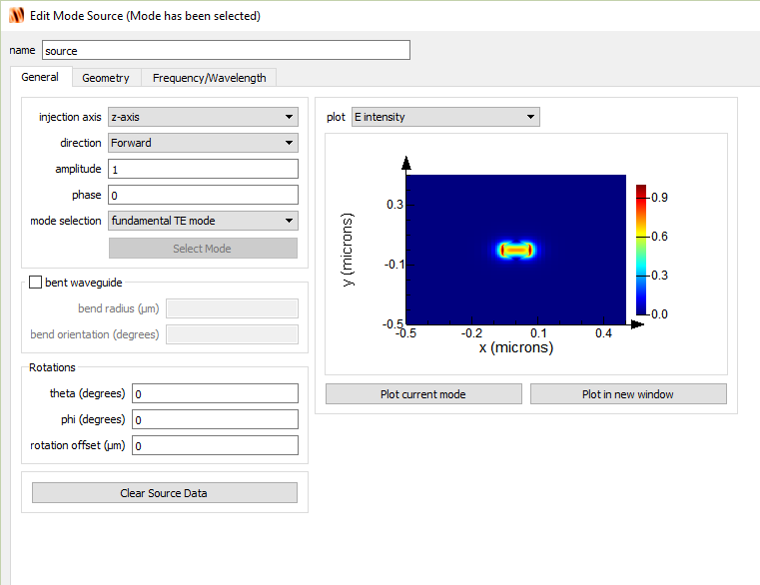
Mode source

Slide 14
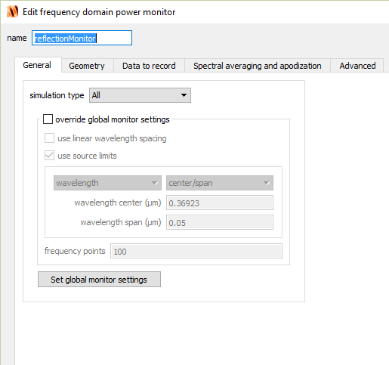
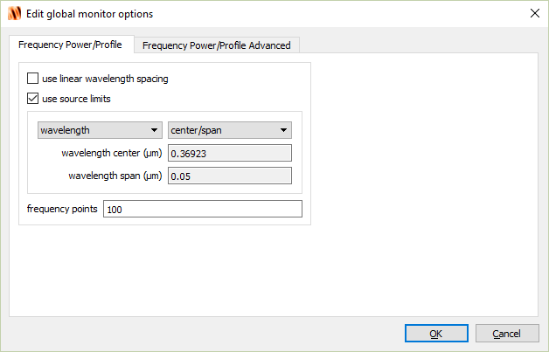
Power monitor

Slide 15
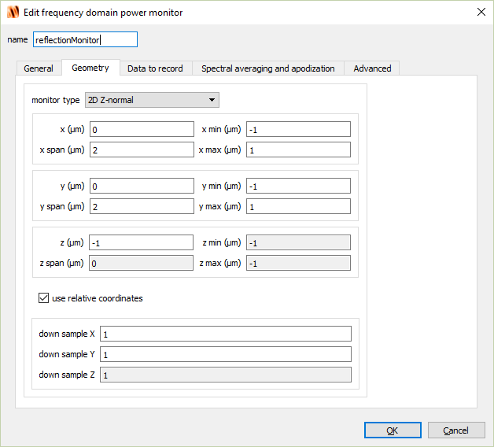
Power monitor

Slide 16
Plotting mirror reflectivity
Run simulation (if not already)
Right-click reflectionMonitor and select Visualize → T
This will plot the percentage of power transmitted through the field-monitor. That is it will tell us much power was reflected from the nanowire laser cavity mirror (i.e. reflectivity)

Slide 17
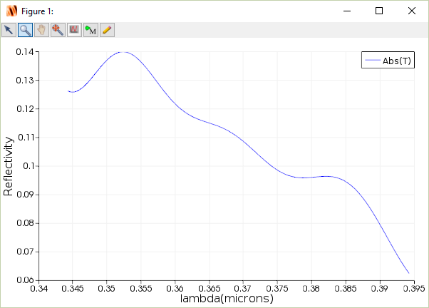
ZnO-Air mirror reflectivity
11% reflectivity

Slide 18
ZnO-Air mirror reflectivity
We measure a reflectivity of 11%. This is slightly lower than our back-of-the-envelope calculation of 18%.
Why?

Slide 19
ZnO-Sapphire reflectivity
Next, we need to simulate the reflectivity of the other mirror.
Click on Layout (where the Run button was) to go back to Layout mode
Right-click on sapphire in the objects tree and click on enable.
Re-run simulation and plot the reflectivity.

Slide 20
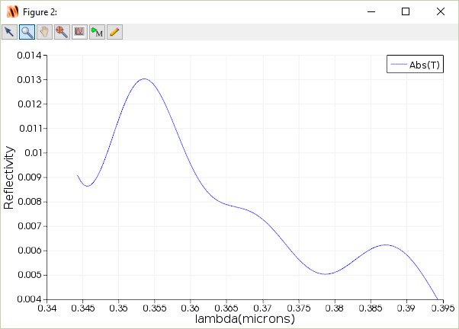
ZnO-Sapphire reflectivity
0.7% reflectivity

Slide 21
Confinement factor
Finally, we need to determine the confinement factor ($Γ)$ where:
$$Γ=\frac{Power inside waveguide}{Total guided power}=\frac{\int_{inside}{Re\left(E×H^{∗}\right)⋅\hat{z} dxdy}}{\int_{total}{Re\left(E×H^{∗}\right)⋅\hat{z} dxdy}}$$
We can do determine the confinement factor by using Lumerical MODE.
Open the file ZnO_nanowire_laser_CF.lms
Click Run, and Calculate modes

Slide 22
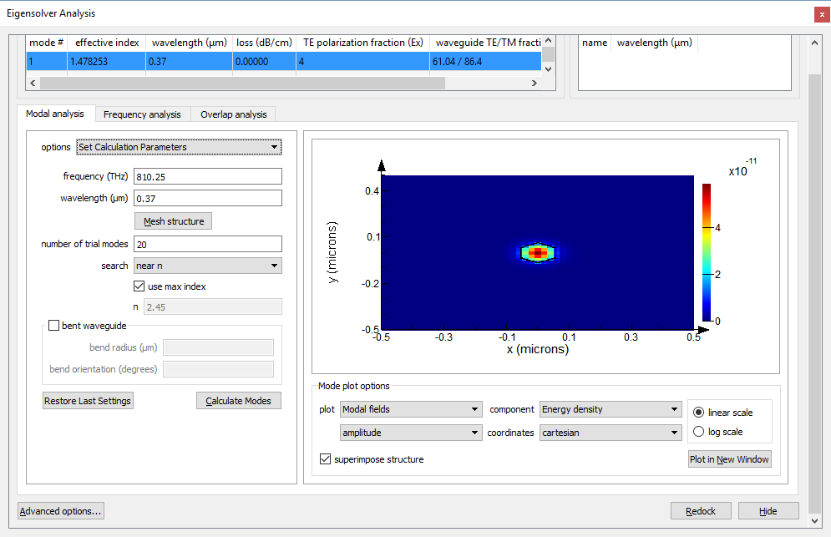
Confinement factor calculation

Slide 23
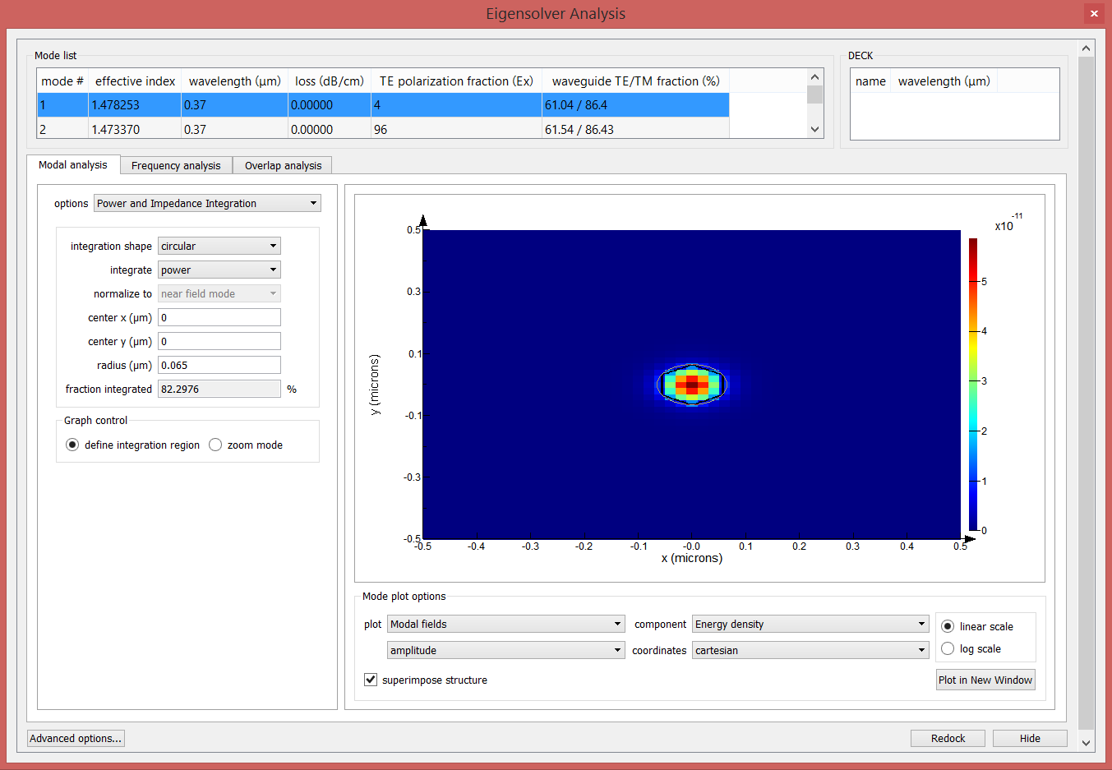
Confinement factor calculation
confinement factor

Slide 24
Confinement factor calculation
We are limited to a circular or rectangular geometry when calculating confinement factor. When waveguide has more complicated geometry (such as ZnO nanowire with hexagonal cross-section) we may wish to more rigorously determine confinement factor by writing a Lumerical script.

Slide 25
Threshold gain calculation
Now, let’s recalculate the threshold gain calculation with our more accurate values for mirror reflectivity and confinement factor.
$$g_{th}=\frac{α_{i}}{Γ}+\frac{1}{2ΓL}\ln\left(\frac{1}{R_{1}R_{2}}\right)$$
Assume nanowire length is 10 µm, and negligible
internal loss
$$g_{th}\sim \frac{1}{(2)(0.82)(10×{10}^{−4})}\ln\left(\frac{1}{(0.11)(0.007)}\right)=4371 cm^{−1}$$
Original estimate was 2800 $cm^{−1}$

